Slide 1
Column Correspondence Theorem

Slide 2
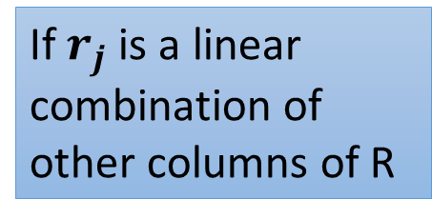
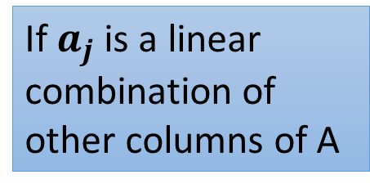
Column Correspondence Theorem
RREF
$$A=\left[\begin{matrix}a_{1} & ⋯ & a_{n}\end{matrix}\right]$$
$$R=\left[\begin{matrix}r_{1} & ⋯ & r_{n}\end{matrix}\right]$$
If $a_{j}$ is a linear combination of other columns of A
$r_{j}$ is a linear combination of the corresponding columns of R with the same coefficients
a₅ = −a₁+a₄
r₅ = −r₁+r₄
$a_{j}$ is a linear combination of the corresponding columns of A with the same coefficients
If $r_{j}$ is a linear combination of other columns of R
a₃ = 3a₁-2a₂
r₃ = 3r₁-2r₂

Slide 3
Column Correspondence Theorem - Example
a₁
a₂
a₃
a₄
a₅
a₆
r₁
r₂
r₃
r₄
r₅
r₆
a₂ = 2a₁
r₂ = 2r₁
Notes:
P118 – 122 (Chapter 2.3)

Slide 4
Column Correspondence Theorem - Example
a₁
a₂
a₃
a₄
a₅
a₆
r₁
r₂
r₃
r₄
r₅
r₆
a₂ = 2a₁
r₂ = 2r₁
a₅ = −a₁+a₄
r₅ = −r₁+r₄
Notes:
P118 – 122 (Chapter 2.3)

Slide 5
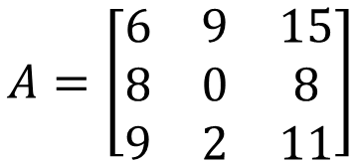
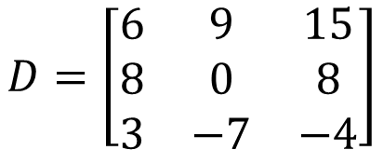
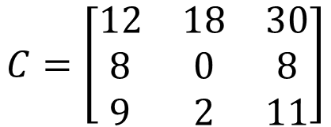
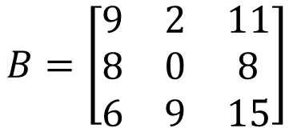
Column Correspondence Theorem – Reason 1
Elementary row operations 無法改變 column 間的關係
$$a_{1}+a_{2}=a_{3}$$
Switch rows 1 and 3
$$A=\left[\begin{matrix}6 & 9 & 15 \\ 8 & 0 & 8 \\ 9 & 2 & 11\end{matrix}\right]$$
row 3 – row 1
$$d_{1}+d_{2}=d_{3}$$
$$b_{1}+b_{2}=b_{3}$$
$$D=\left[\begin{matrix}6 & 9 & 15 \\ 8 & 0 & 8 \\ 3 & −7 & −4\end{matrix}\right]$$
$$B=\left[\begin{matrix}9 & 2 & 11 \\ 8 & 0 & 8 \\ 6 & 9 & 15\end{matrix}\right]$$
row 1 x 2
$$c_{1}+c_{2}=c_{3}$$
$$C=\left[\begin{matrix}12 & 18 & 30 \\ 8 & 0 & 8 \\ 9 & 2 & 11\end{matrix}\right]$$

Slide 6
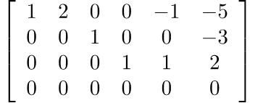
Column Correspondence Theorem – Reason 2
Basic concept
RREF
還是 RREF
… 不好說

Slide 7
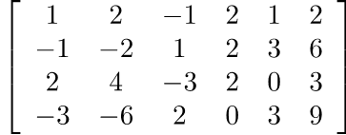
Column Correspondence Theorem – Reason 2
Basic concept
RREF
Augmented Matrix:
$$\left[\begin{matrix}A & b\end{matrix}\right]$$
$$\left[\begin{matrix}R & b\end{matrix}′\right]$$
RREF
Coefficient Matrix:
$$A$$
$$R$$
A
R
$$\left[\begin{matrix}A & b\end{matrix}\right]$$
$$\left[\begin{matrix}R & b′\end{matrix}\right]$$

Slide 8

Column Correspondence Theorem – Reason 2
The RREF of matrix A is R
The RREF of augmented matrix $\left[\begin{matrix}A & b\end{matrix}\right]$ is $\left[\begin{matrix}R & b′\end{matrix}\right]$
The RREF of matrix A is R
$Ax=b$ and $Rx=b$ have the same solution set?
$Ax=b$ and $Rx=b′$ have the same solution set
$Ax=0$ and $Rx=0$ have the same solution set
If $b=0$, then $b′=0$.
Notes:
P120

Slide 9


Column Correspondence Theorem – Reason 2
The RREF of matrix A is R, $Ax=0$ and $Rx=0$ have the same solution set
a₁
a₂
a₃
a₄
a₅
a₆
r₁
r₂
r₃
r₄
r₅
r₆
a₂ = 2a₁
$$x=\left[\begin{matrix}\begin{matrix}−2 \\ 1 \\ 0\end{matrix} \\ \begin{matrix}0 \\ 0 \\ 0\end{matrix}\end{matrix}\right]$$
$$x=\left[\begin{matrix}\begin{matrix}−2 \\ 1 \\ 0\end{matrix} \\ \begin{matrix}0 \\ 0 \\ 0\end{matrix}\end{matrix}\right]$$
r₂ = 2r₁
$$Ax=0$$
$$Rx=0$$
-2a₁+a₂=0
-2r₁+r₂=0

Slide 10


Column Correspondence Theorem – Reason 2
The RREF of matrix A is R, $Ax=0$ and $Rx=0$ have the same solution set
a₁
a₂
a₃
a₄
a₅
a₆
r₁
r₂
r₃
r₄
r₅
r₆
a₅ = −a₁+a₄
$$x=\left[\begin{matrix}\begin{matrix}1 \\ 0 \\ 0\end{matrix} \\ \begin{matrix}−1 \\ 1 \\ 0\end{matrix}\end{matrix}\right]$$
$$x=\left[\begin{matrix}\begin{matrix}1 \\ 0 \\ 0\end{matrix} \\ \begin{matrix}−1 \\ 1 \\ 0\end{matrix}\end{matrix}\right]$$
r₅ = −r₁+r₄
$$Ax=0$$
$$Rx=0$$
a₁-a₄+a₅=0
r₁-r₄+r₅=0

Slide 11
How about Rows?
NO
Are there row correspondence theorem?
$$a_{1}^{T}$$
$$r_{1}^{T}$$
$$a_{2}^{T}$$
$$r_{2}^{T}$$
$$a_{3}^{T}$$
$$r_{3}^{T}$$
$$a_{4}^{T}$$
$$r_{4}^{T}$$

